Slide 1
AI Term Project Proposal
Bryce Titus, Kyle Muldoon, Kenneth Yao

Slide 2
Tic-Tac-Toe Game
Sample code of a Tic-Tac-Toe game in Python that implements different machine learning algorithms
GitHub: https://github.com/Cledersonbc/tic-tac-toe-minimax/blob/master/py_version/minimax.py
Our project will be an implementation of a Tic-Tac-Toe tournament game, utilizing Minimax algorithm.

Slide 3
Implementing Minimax Algorithm
Parameters:
State: Contains information regarding the current state of the Tic-Tac-Toe game
Depth: The node index in the tree (0 <= depth <= 9)
Player: Indicates whether it is the computers or the human player’s turn
Returning: The algorithm would then return a list containing the best row, column, and score for each move.
Initialize a “best score” variable for both the computer and human player
Update the score after the minimax algorithm runs and input the value back into the “best score” variable

Slide 4
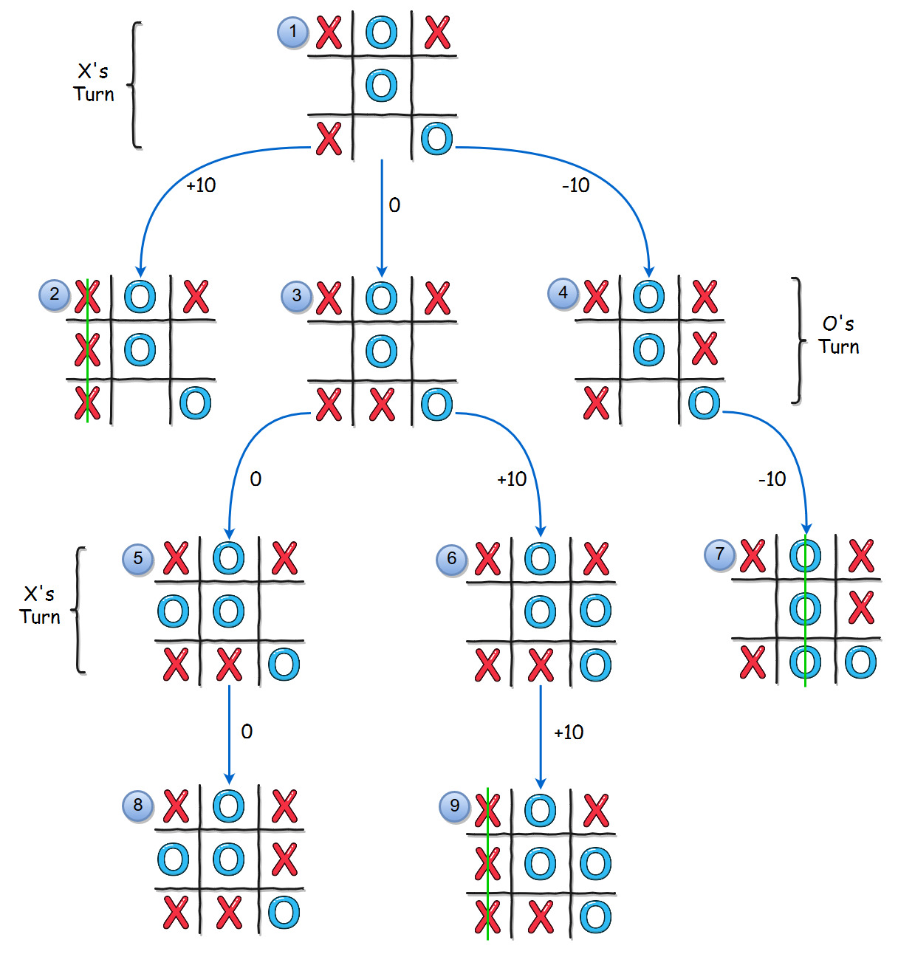
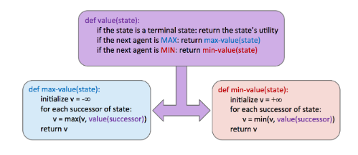
Minimax Algorithm Cont.
These diagram shows how the Minimax algorithm works when selecting its moves.

Slide 5
Project Objectives
To create a fully functioning Tic-Tac-Toe game played between two agents (Players 1 & 2).
Both agents will play Tic-tac-toe in a tournament setting (Best Out of Three)
The agent that wins the most games is the winner

Slide 6
Approach
We will build classes and implement different functions to switch between multiple players
Introduce a match tracker to count the number of won sets and declare the final winner
We intend to implement the minimax algorithm for our model.
We will utilize and implement the algorithm where the Agent plays optimally regarding their current state

Slide 7
Deliverables
We will have a fully built Tic-Tac-Toe Game with AI techniques implemented in.
We will have a functioning tournament system that tracks wins by each agent.
Replit Code:
https://replit.com/@KyleMuldoon/TicTacToe-AI#main.py

Slide 8
Evaluation Methodology
Within our code, we will have implemented at least all the algorithms that are mentioned in our approach; additionally, we may choose to include more algorithms when we encounter any inefficiencies when using our current methodology.

